Slide 1
1541 Research Activity Overview Sandia PSAAP-3 Internship Talking Points
Stefan Domino (1541)
Overview of Domino’s 1541 research activity
SAND2021-15788 HR

Slide 2
Objective
These set of slides provide a window into possible low-Mach research themes to explore in a PSAAP-3 internship
Sandia is a large laboratory; research themes including:
Multi-phase flow, thermal applications, compressible flow, solvers, next-generation platforms and code design, fires, machine learning, etc.
Fluid modeling approaches including RANS, LES, and DNS
For more information on such non-low-Mach research themes, let me (spdomin@sandia.gov) know and I can provide Sandia contacts that provide a better match
Some projects interface an open-source tool, Nalu, while others interface our internal mod/sim tools, Sierra/Fuego

Slide 3
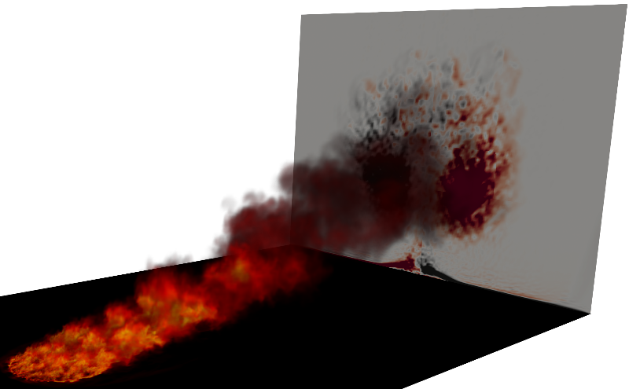
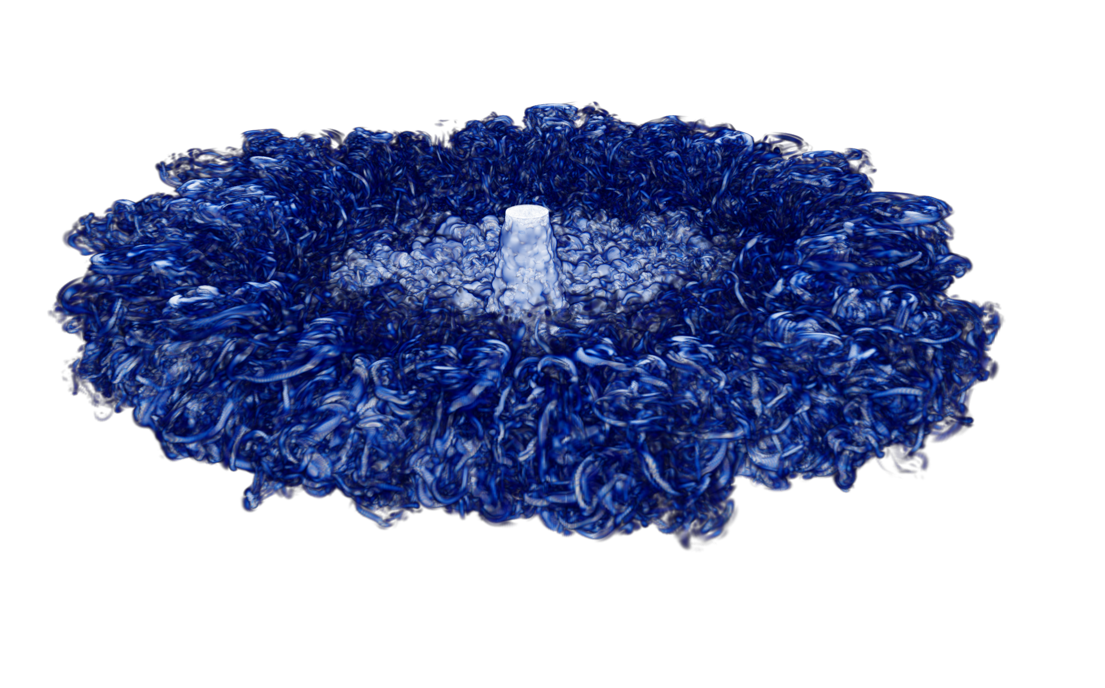
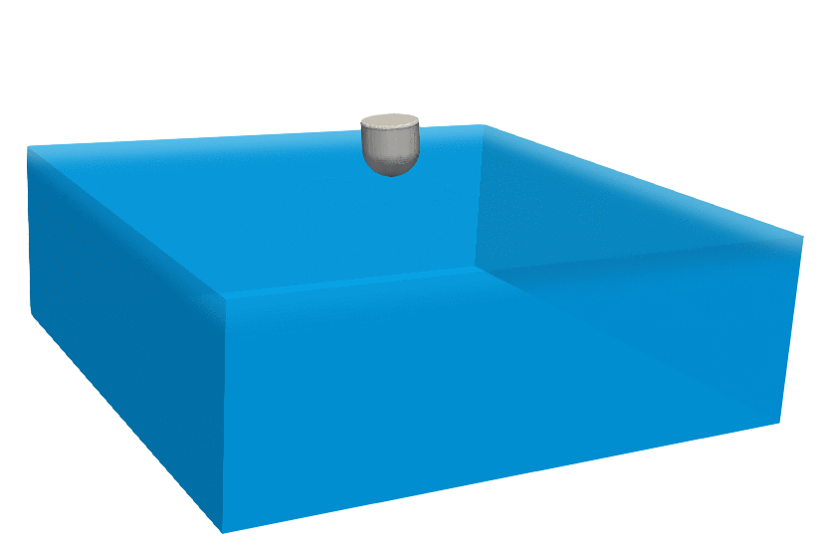
Research Activities Center on low-Mach Flow
Theme: variable-density, low-Mach fluids - often times reacting, turbulent and multi-physics
Hydrocarbon-based fires: uncertainty quantification
Unsteady flamelet-, LES-based
participating media radiation and object heat-up
Impinging jets: physics elucidation
DNS-based
Multiple inlet temperatures in ambient
Wave Energy Converter: credible mod/sim tools
Six-DOF, VoF, overset
COVID-19: credible mod/sim
High-fidelity-based approach (point-Lagrangian/Eulerian) to modeling transport and transmission
LES Wall-modeling approaches: Consistent & Accurate
Current focus is on a consistent approach for k_{SGS}
10 m circle in 10 m/s crossflow
Re 10K impinging jet; 100C
WEC displacement validation

Slide 4
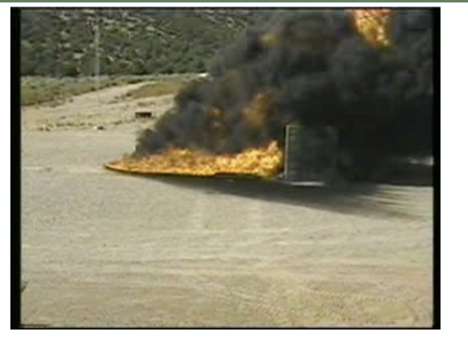
Advancing Fire Mod/Simulation An Evolution of Mindset: Quiescent to Crossflow
Three overarching goals recognizing that peak radiative/convective heat fluxes to engulfed objects is a function of fuel type, pool size, obstructions/accident geometry, and presence of crossflow – all within a required large-eddy simulation (LES)-based paradigm
Provide first validation for large-eddy simulation-based second-generation full physics fire modeling suite
Drive fundamental automatic structural uncertainty (model-form sensitivity) for LES
Deploy uncertainty quantification for radiative heat flux as a function of pool shape and crosswind magnitude
RANS-based
LES-based
Quiescent; q”_{r} ~ 100 kw/m²
Crossflow; q”_{r} ~ 200 kw/m²
Whirls; > 200 kw/m²

Slide 5
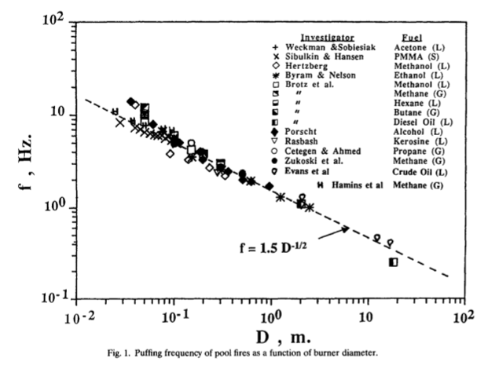
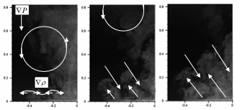
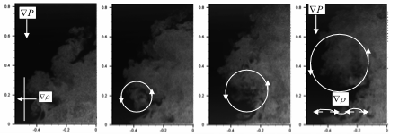
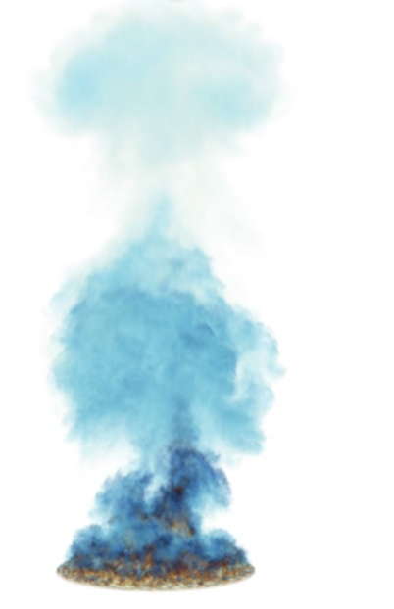
Quiescent to Crossflow Fire/Plume Physics
Cetegen and Ahmed, C&F 1993
Quiescent fires puff
Finding: The inclusion of a crossflow wind profile couples vorticity of the pool and streamwise momentum that drives the formation of column vortices, increases the importance of mixing and, therefore, convective loads on the object become more important
Change in mindset: Invest in validation use cases to highlight the importance of fire accident scenarios in the presence of crossflow
Evolution of a Puff Cycle (O’Hern et al., JFM, 2005)
Fric and Roshco, JFM, 1994 (left)
Helium DNS, Domino, 2016

Slide 6
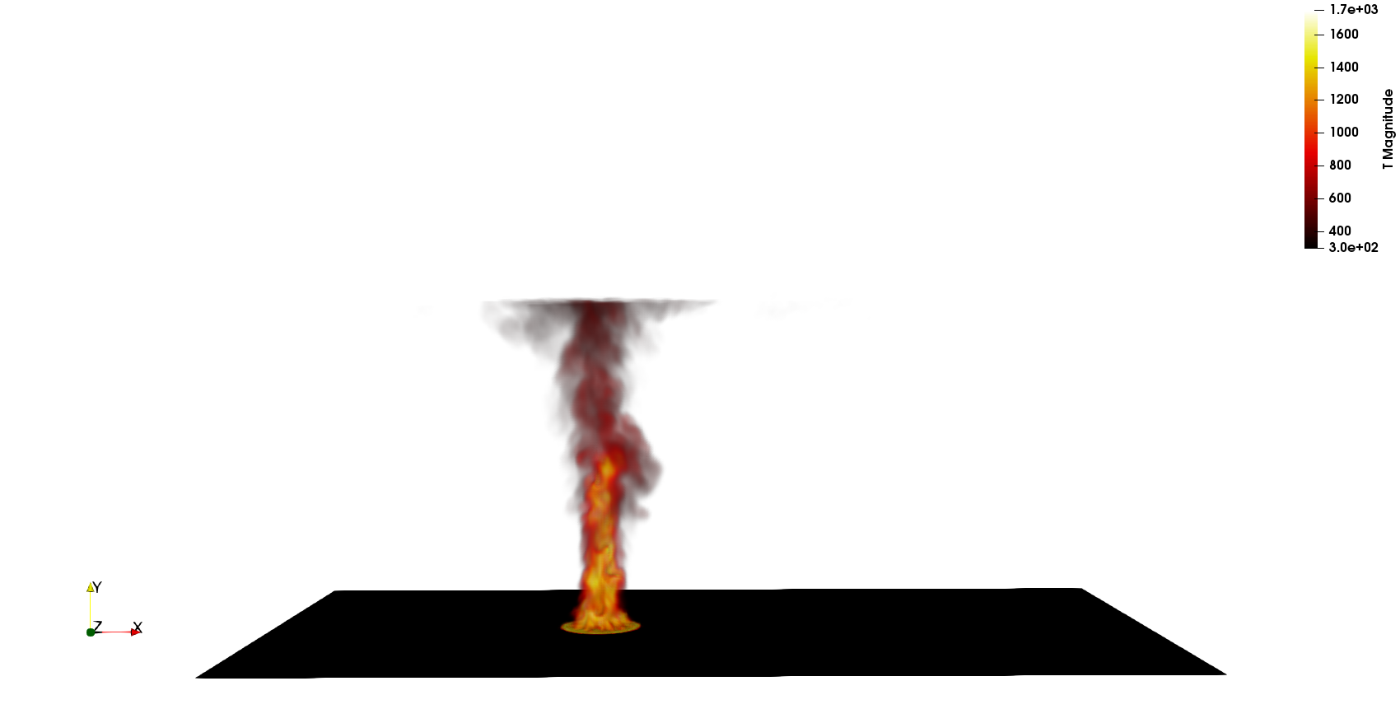
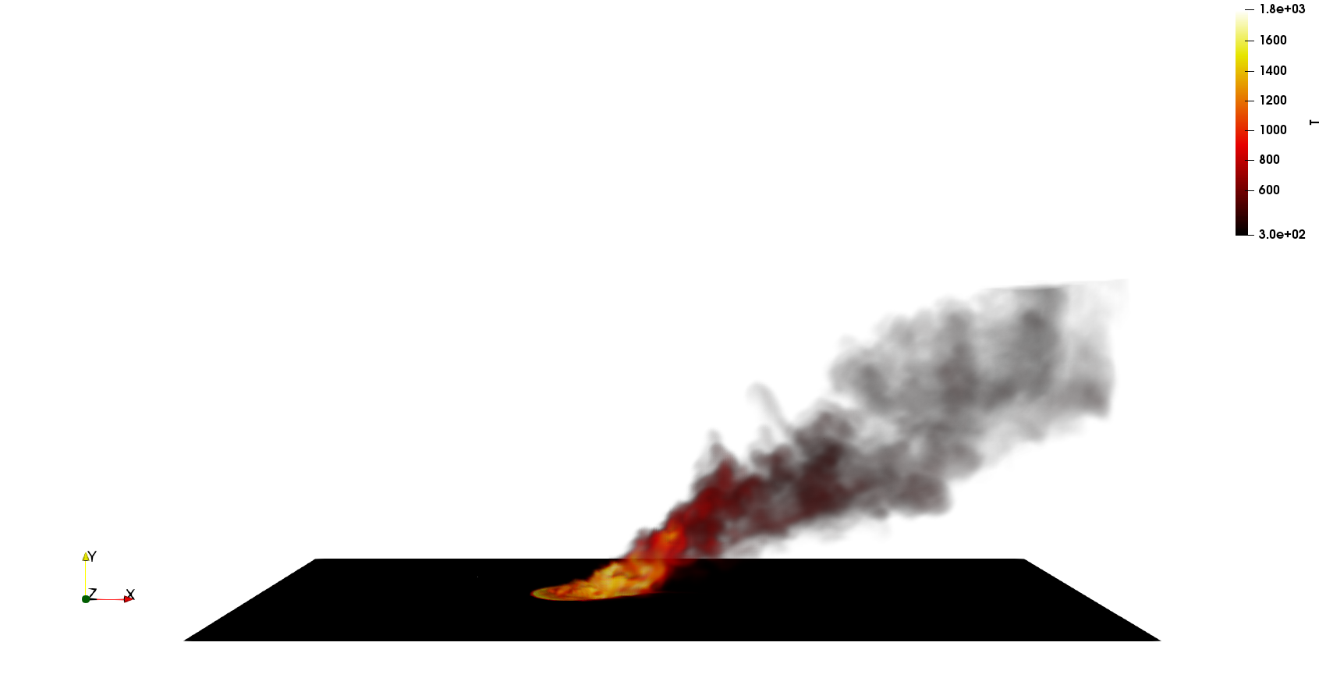
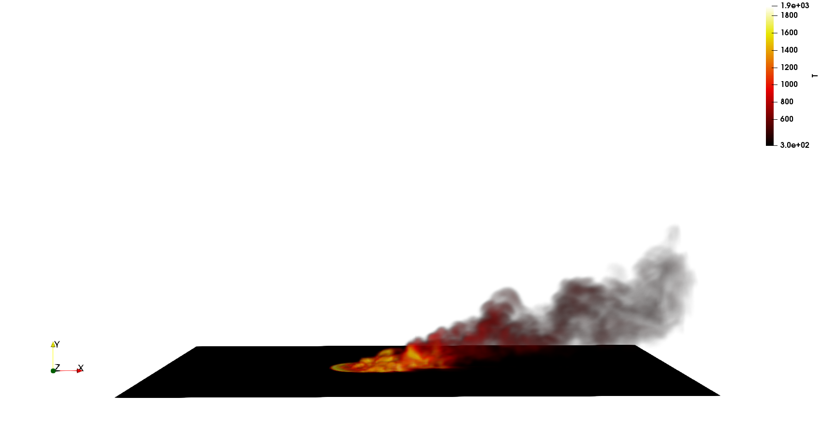
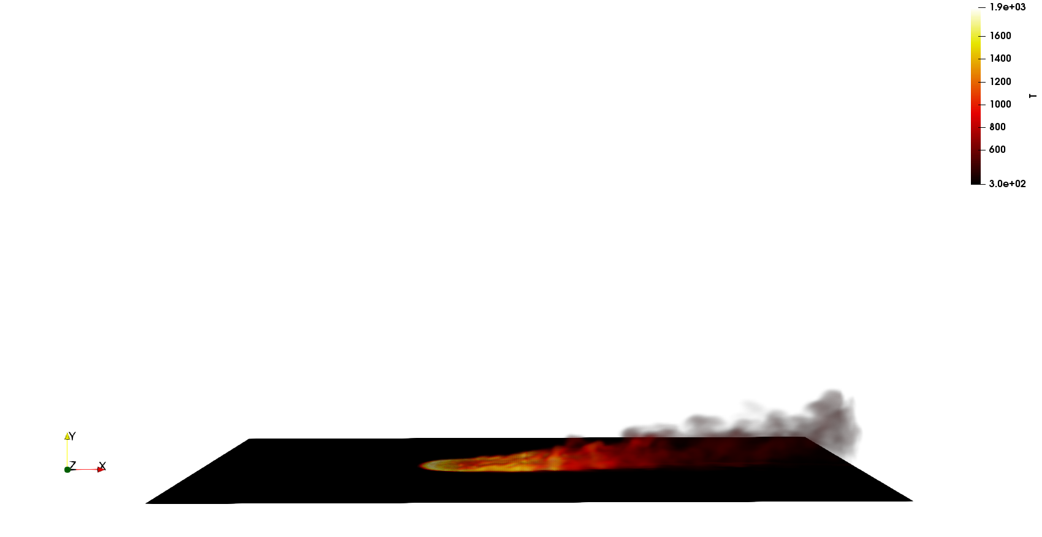
The Effect of Crossflow
Although bench scale efforts exist for quantities such as flame drag distance and tilt angles, none exist for this scale of interest, e.g., 10 meters and beyond
Approach: We (PI Domino and Scott, ASC V&V) are quantifying large-scale fire physics (G, q^{Rad}, etc.) through theory (Mahesh, Annual Rev. Fluid Mech, 2013) and high-fidelity LES
Step 1: How does pool shape, i.e., circles, squares, and rectangles, (at fixed area), in various cross flow configurations affect peak heat flux magnitude and location?
Step 2: Explore flame dynamics in the presence of probabilistic boundary layer crossflow
Step 3: Explore damaged state configuration
~0 m/s
q”_{r}~ 150 kW/m²
5 m/s
q”_{r}~ 180 kW/m²
10 m/s
q”_{r}~ 206 kW/m²
20 m/s
q”_{r}~ 330 kW/m²
Scott and Domino, 10 m pool fire
LES-based numerical study with varying crosswind

Slide 7
Fire Mechanics Coupling Description: In Words
Temperature
Irradiation
Conduction
Heat Transfer,
Enclosure Radiation
SURFACE
Participating
Media
Radiation DOM
Operator-split
Transfer
Temperature, μ_{g}
RTE Src
Linearized
Temperature
Convection Coef.
Reference Temp
SURFACE
۰q_{r}
VOLUME
Δ
Monolithic, i.e., fully coupled, approaches are intractable due to the size of (u, v, w, p, h, h^{r}, Z, I^{k} , T)^{T}
Stable and accurate operator split methods are, therefore, sought
See Domino et al., AIAA, 2007
Turbulent
Fluid Mechanics,
Combustion

Slide 8
Fire Mechanics Coupling Description: Equations
Favre-averaged, variable-density, low-Mach equation set using large-eddy simulation (LES)
Given filter:
Subgrid Stress (SGS):
mixture fraction-based unsteady flamelet combustion with generalized heat loss (multi-D table look-up; presumed PDF)
Soot: Koo et al. (2018) from Moss and Askit (2007)
Closure:
LES Models:
Smagorinsky:
k_{SGS}:
WALE:
Unsteady flamelet example

Slide 9
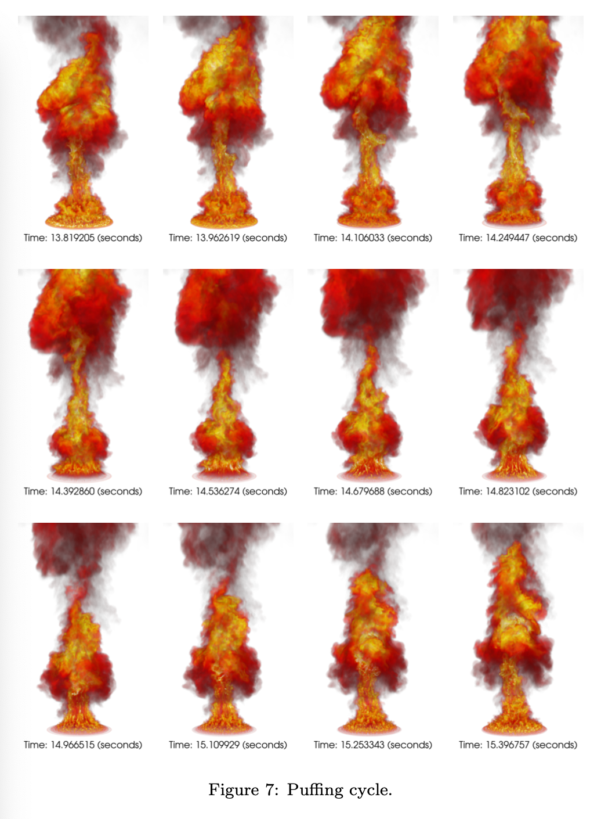
LES-based 5 meter Pool Fire Validation
Puffing is captured– a key feature found in pool fires due to the complex interaction of Rayleigh/Taylor instabilities, Baroclinic torque, and vertical acceleration of vortical ring structures: 0.60 Hz vs correlation, 0.67 Hz
Radiative heat flux well-predicted
See: Domino et al., “Predicting large-scale pool fire dynamics using an unsteady flamelet and large-eddy simulation-based model suite”, PoF, 2021 (Editors pick)

Slide 10
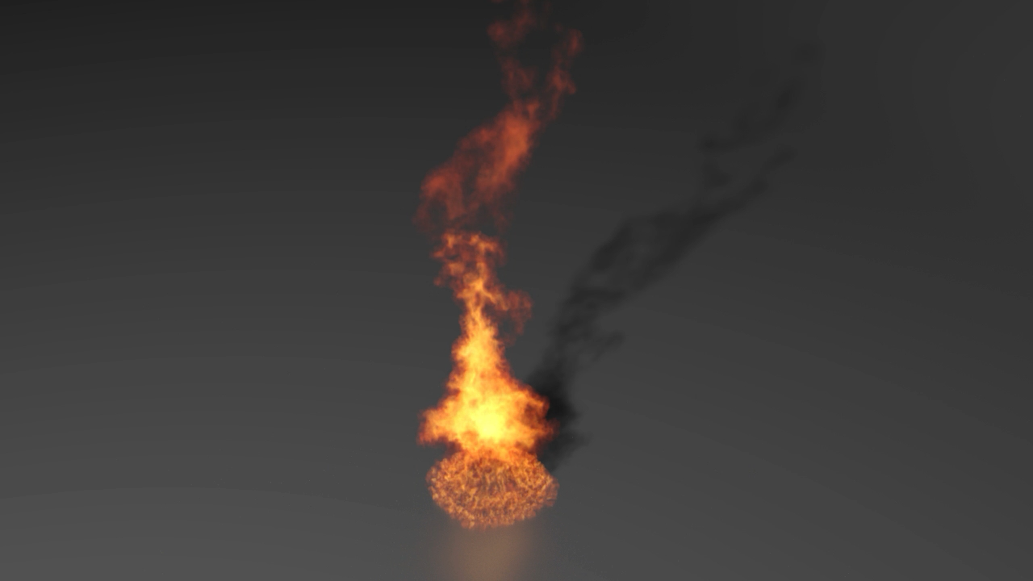
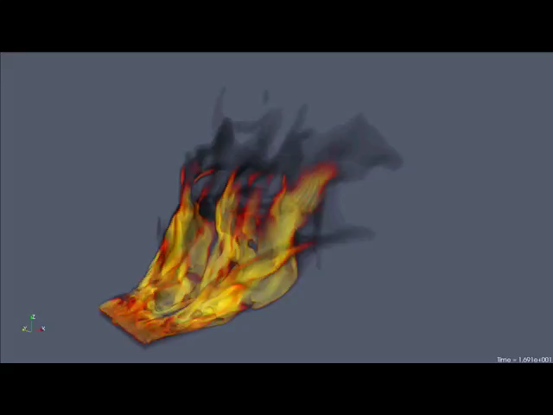
Representative Crossflow and Quiescent Simulations
5 meter JP-8 (quiescent)
XTF JP-8 (crossflow)

Slide 11
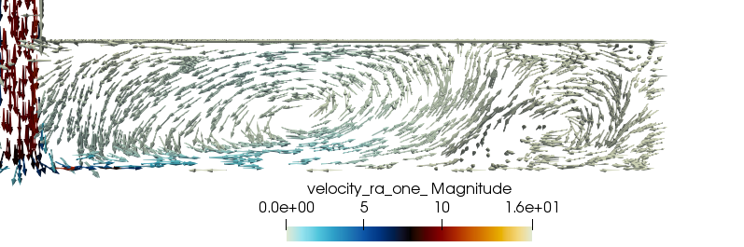
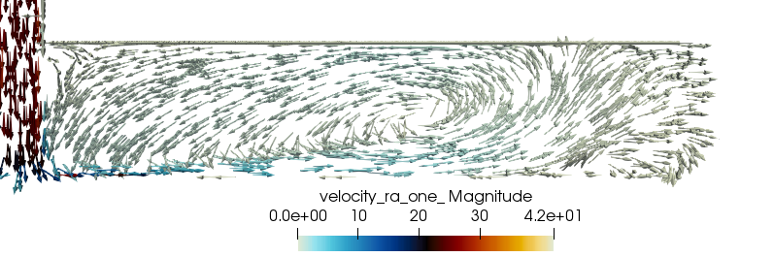
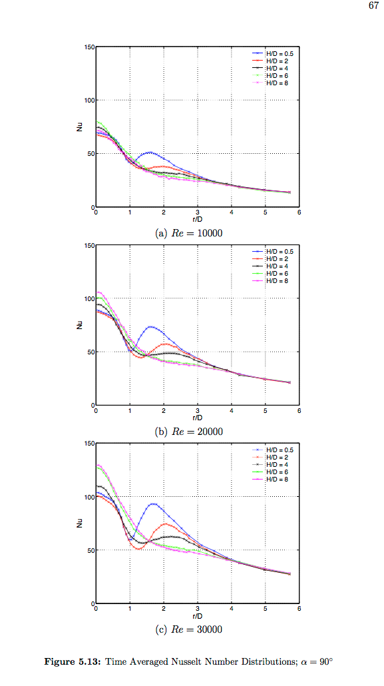
Physics of Impinging Jets
Large-scale vortex radius trend:
Re 8,500
Re 23,000
Baughn and Shimizu, ASME 1989.

Slide 12
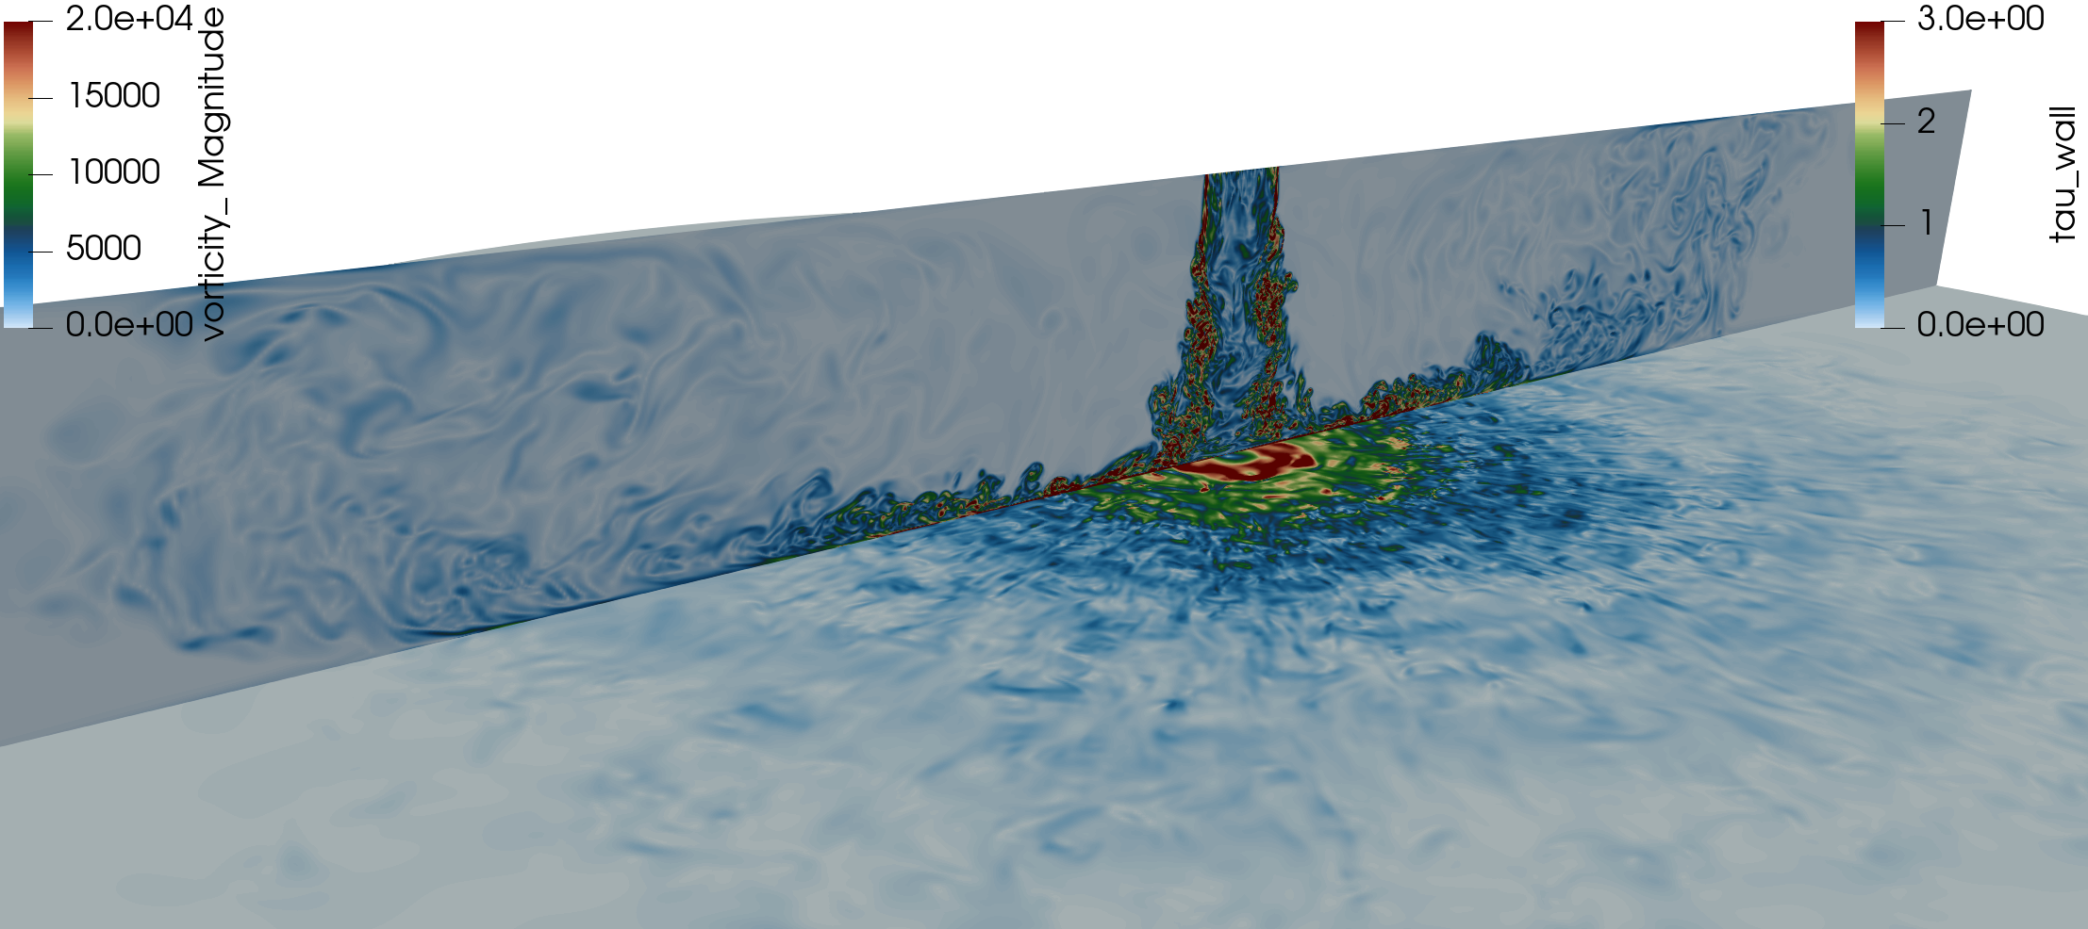
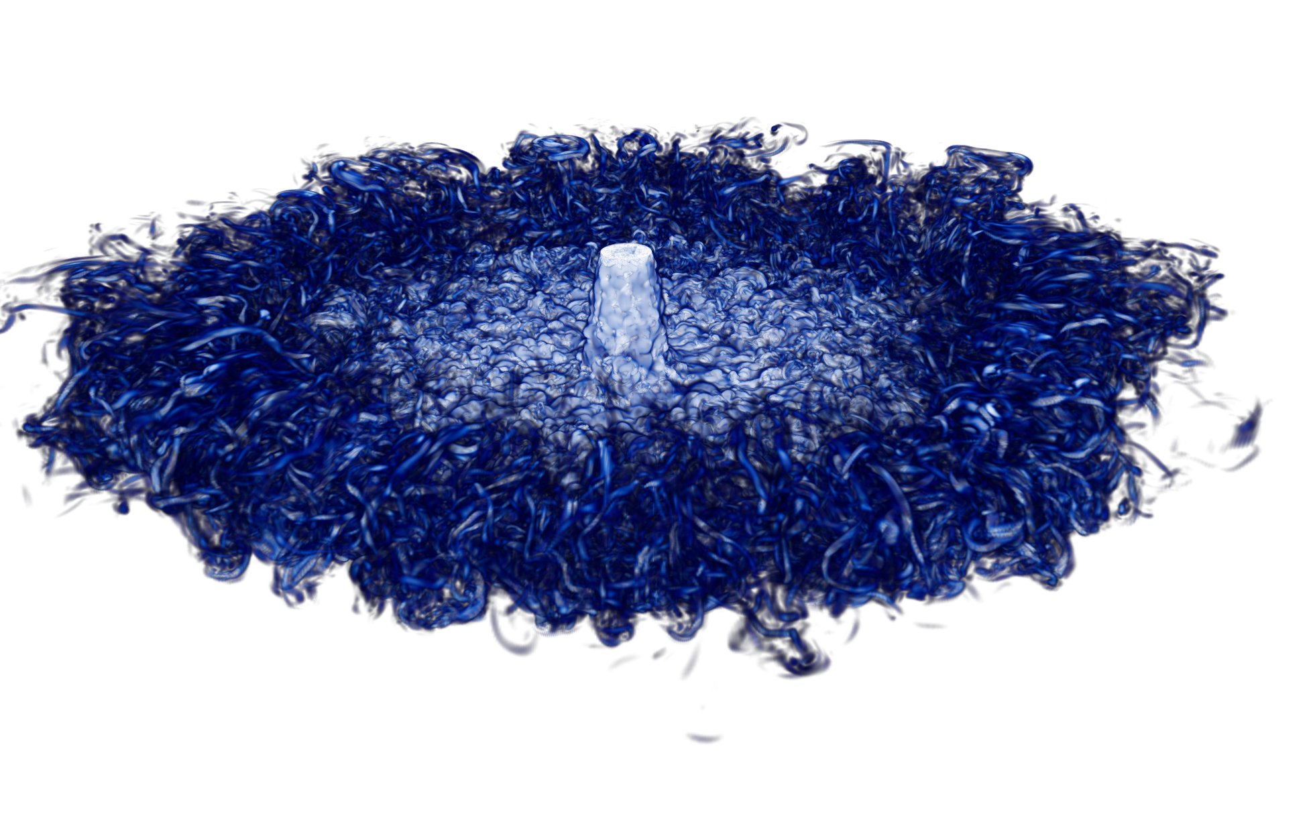
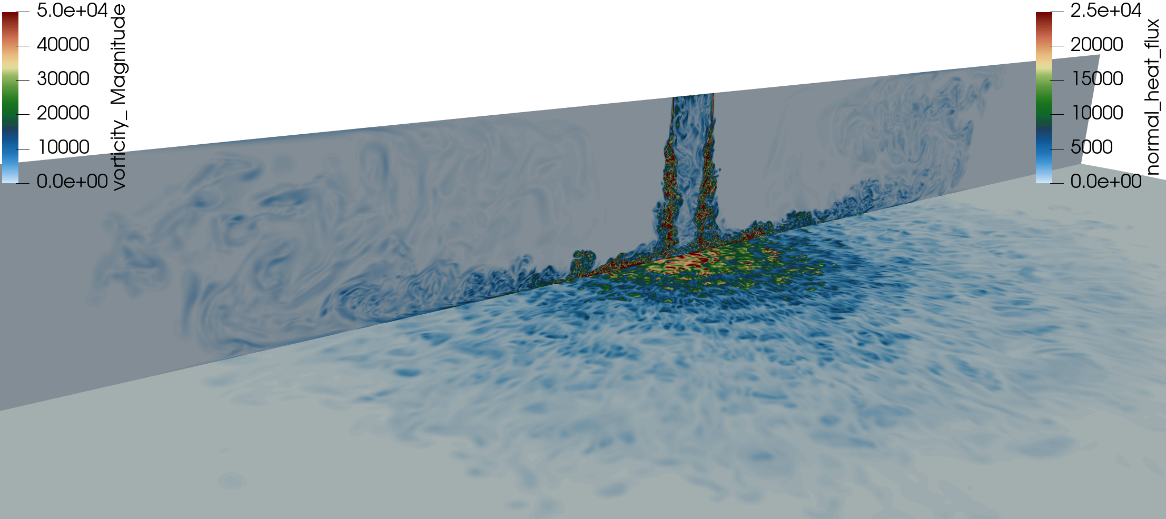
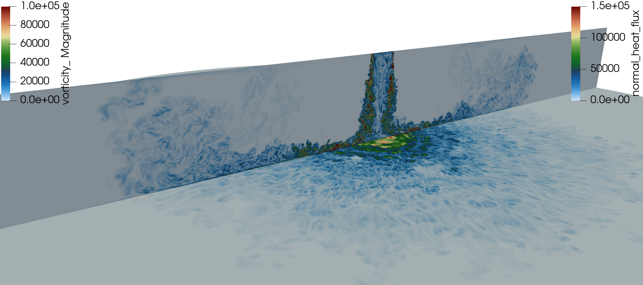
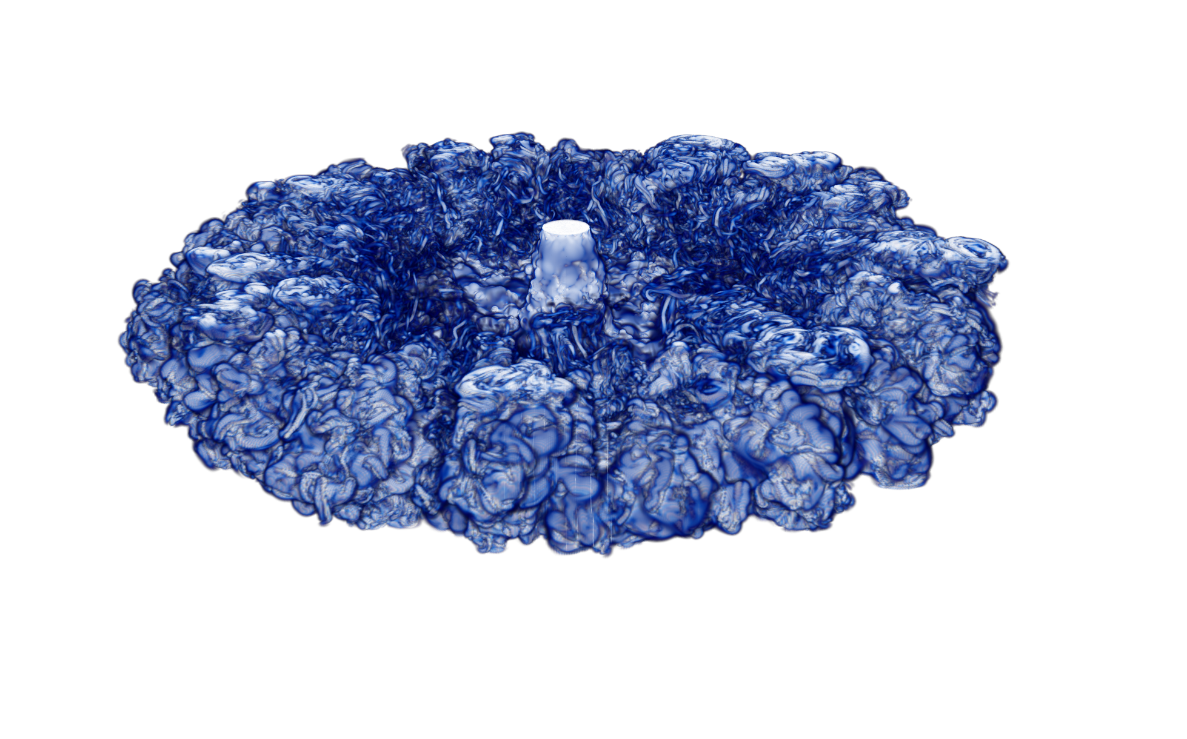
DNS: ASC P&EM Impinging Jet
Trinity ATCC Campaigns have exercised a combined ~20,000 CPU-YEARS
Each case: O(50) restarts; 2000 nodes/24 hr; O(200)K time steps
Increased radial vortex core due to lower radial turbulent fluctuations that drive lower levels of mixing
25C
100C
300C
Vorticity shadings with impingement plate
τ^{w} (25C) or heat flux 100C and 300C
Volume-rendered Q-criterion

Slide 13
Surface Profiles: Well-resolved and Converged
Findings
Let H/D = 3; S = ρ^{jet}/ρ^{amb}
As S decreases, open-jet core collapse distance decreases (generally open jets show a deviation starting at r/D ~3)
Increased radial fluctuations drive increased mixing through increased entrainment
Histogram of heat flux at impingement point shifts from Gaussian (100C) to bi-modal (300C)

Slide 14
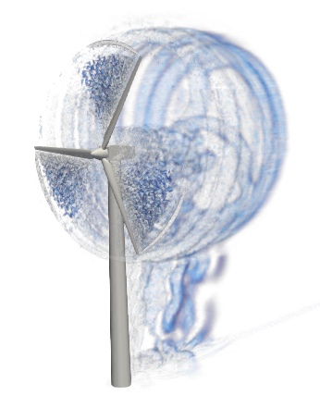

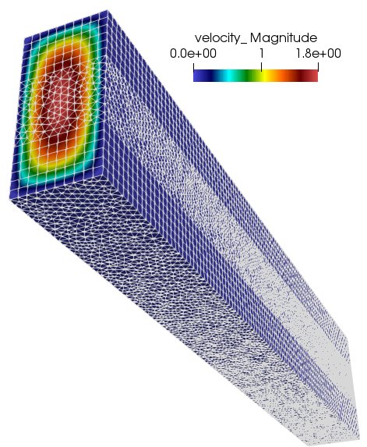
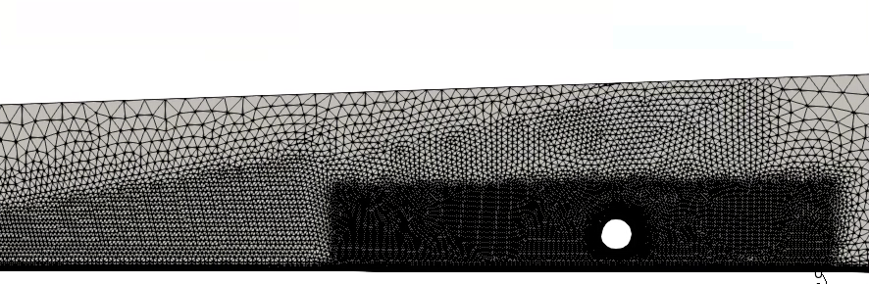
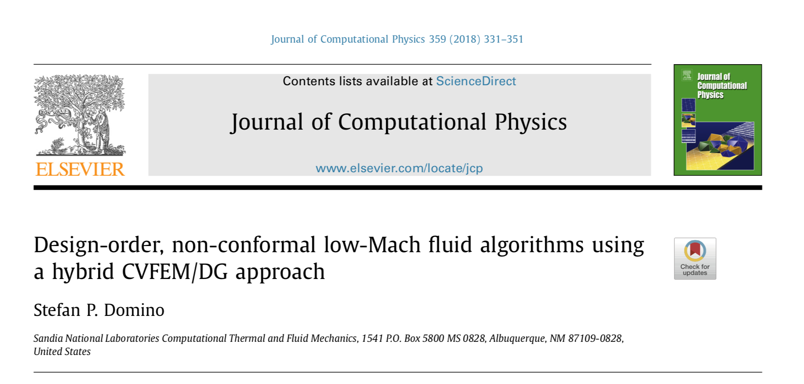
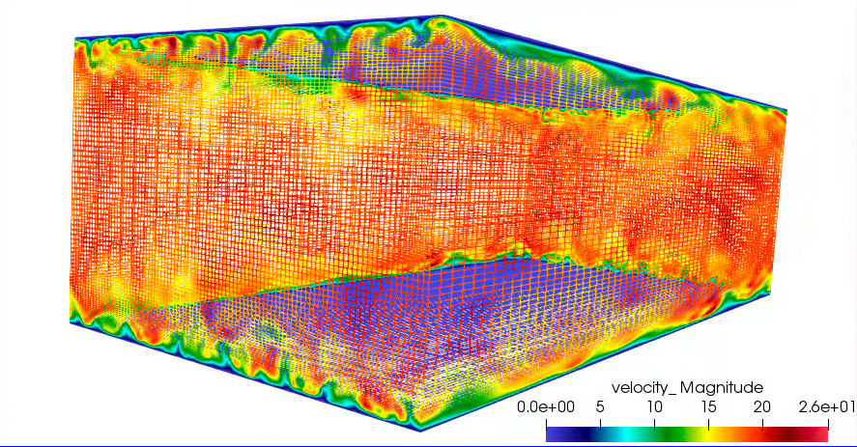
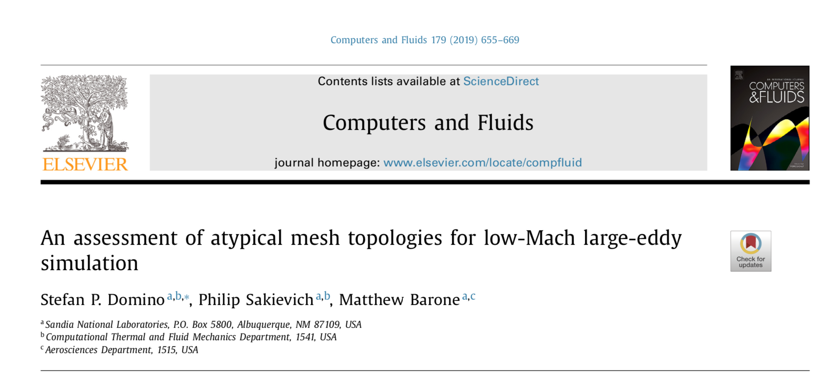
Confidence Established for Atypical Element Types
Verification
Validation

Slide 15
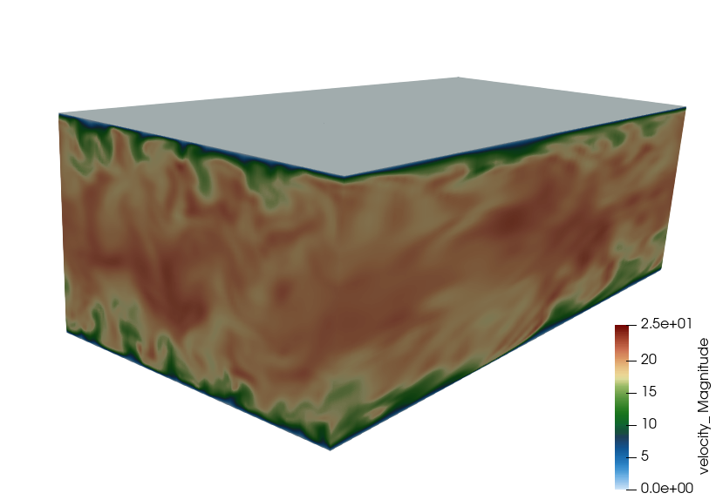


Re^{τ} 395 LES Comparisons with Moser et al. (1999) DNS Channel
Recovered cubit functionality of turbulent viscosity
The baseline one-equation k_{SGS} equation LES-based model fails in the wall-resolved regime
Missing appropriate near-wall dampening
A number of corrections to this baseline have been proposed; recent best:
Inagaki, “A new wall-damping function for large eddy simulation employing Kolmogorov velocity scale”, Int. J. Heat Fluid Flow, 32, 26-40, 2011
Standard model reduces u^{τ} – a quadratic
functionality on predicted heat flux

Slide 16
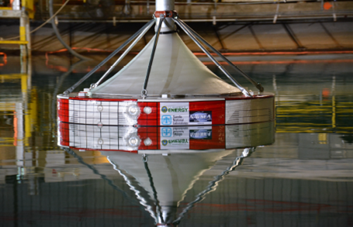
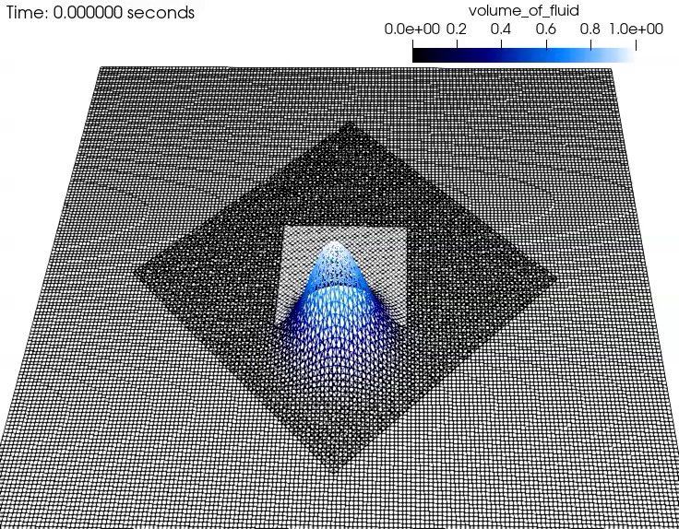
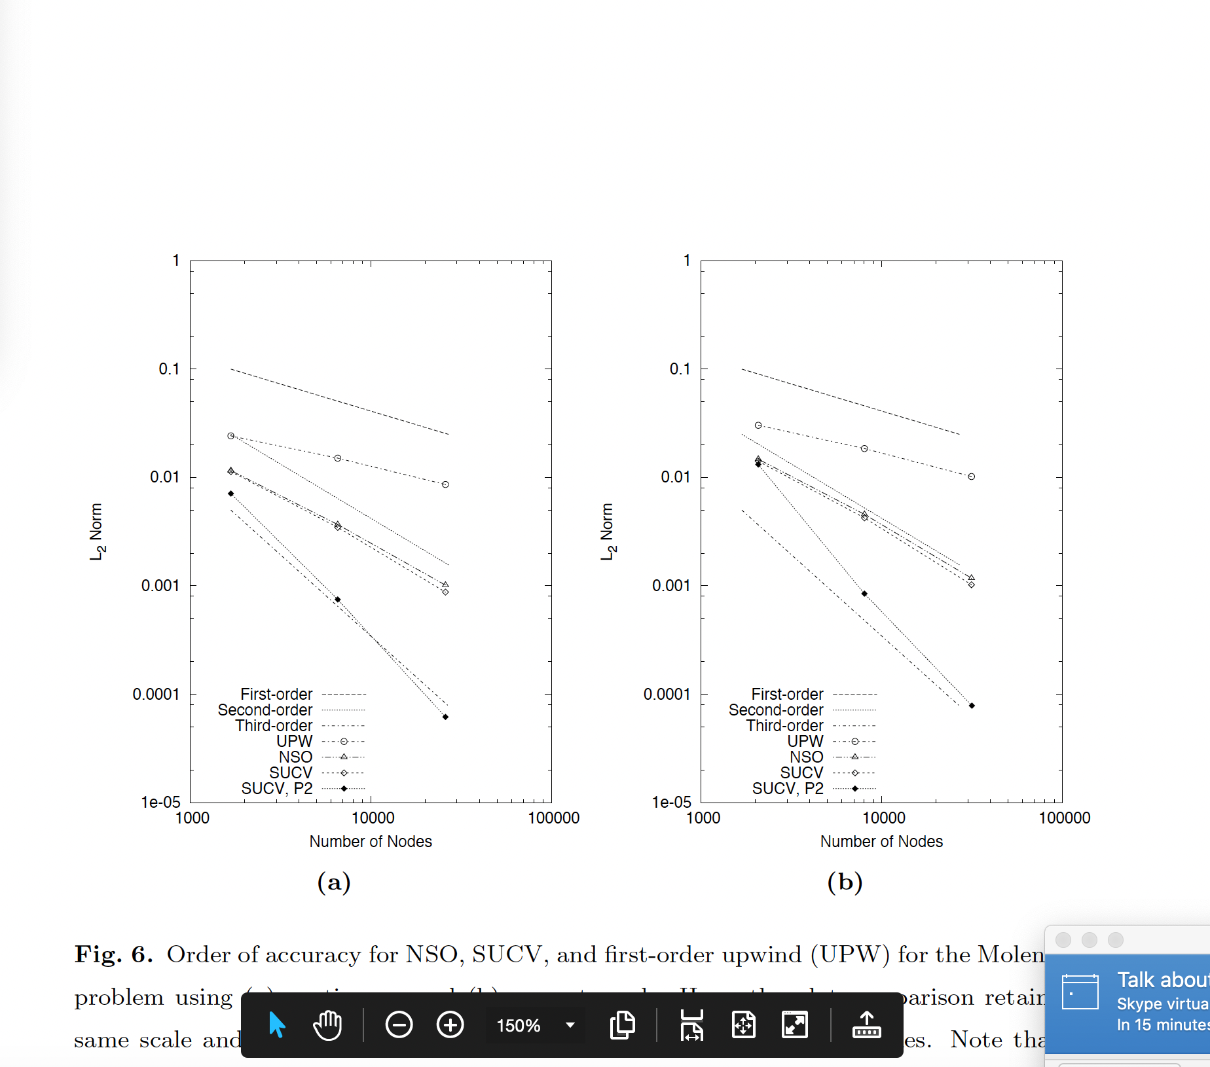
Objective: Stable, Accurate six-DOF + Overset + Volme of Fluid (VoF)
Design-order accuracy provided in Domino, S. P. and Horne, W., "Development and deployment of a credible unstructured, six-DOF, implicit low-Mach overset high-fidelity simulation tool for wave energy applications”, submitted to Renewable Energy and is under review (12/03/2021)
Objective Met: Drive new design-order stabilization approaches for VoF
Coe et al, SAND2016-10094

Slide 17
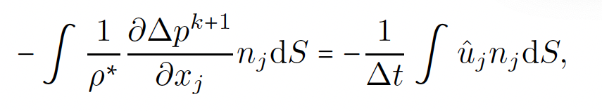
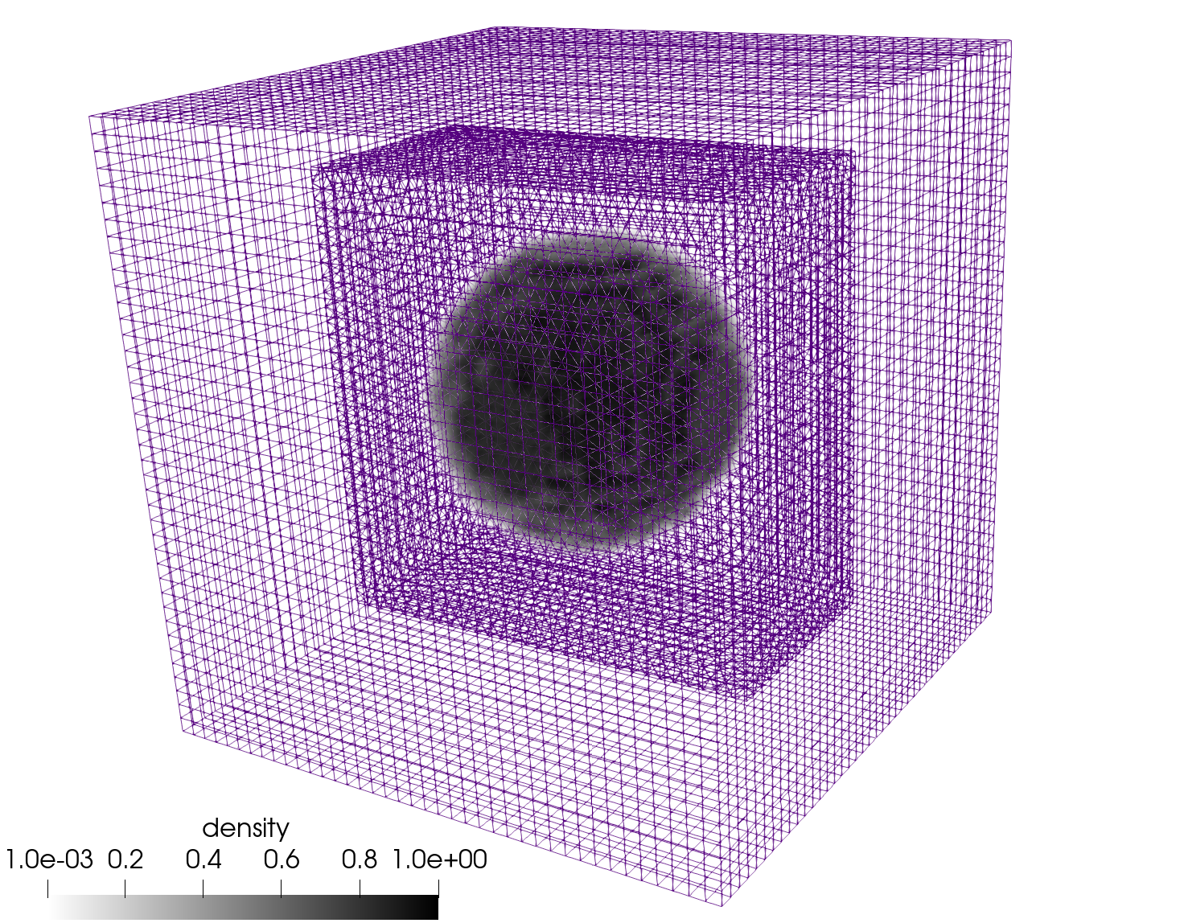
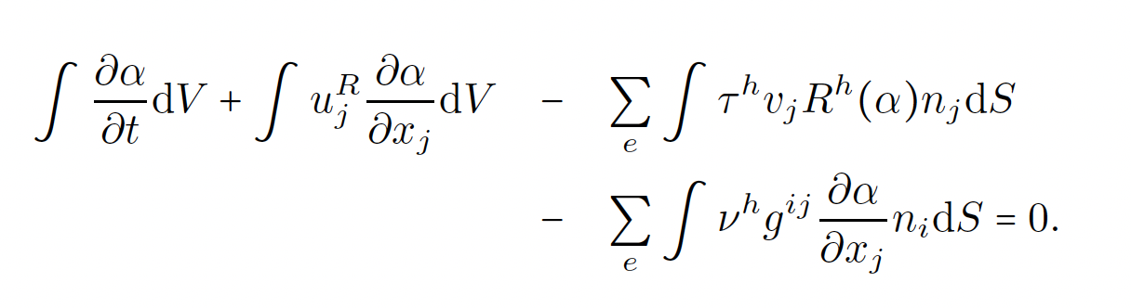
VoF using Balanced Force: Routine Balanced Force + Innovative Stab.
Classic Balanced Force (Francois, JCP, 2006) ported to CVFEM
Generalized, unstructured
Parasitic currents suppressed via a consistent momentum/continuity stabilization approach
Advancing stabilization approaches via the development and deployment of residual-based methods
Note: benefits from ρg_{i} included in stabilization
Hex8/Tet4 Balanced Force Static Bubble;
density ratio = 1000

Slide 18
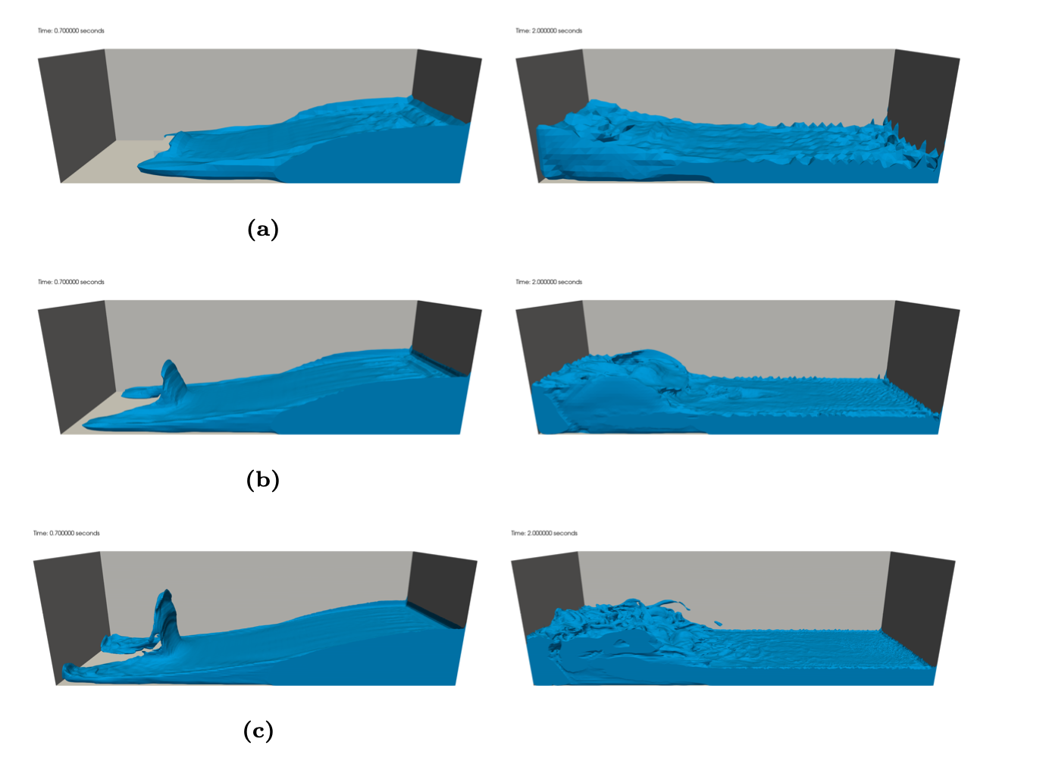
Dam Break Validation
0.7 seconds 2.0 seconds
Validation case of Kleefsman et al. ”A volume-of-fluid based simulation method for wave impact problems”, JCP, 2005.
Qualitative comparisons also made to in-house effort in Fuego, Brown et al. “Modeling a rubble fire consisting of comingled liquid and solid fuel”, Tech. Rep. SAND2017- 12318C, 2017.
R0
R1
R2

Slide 19
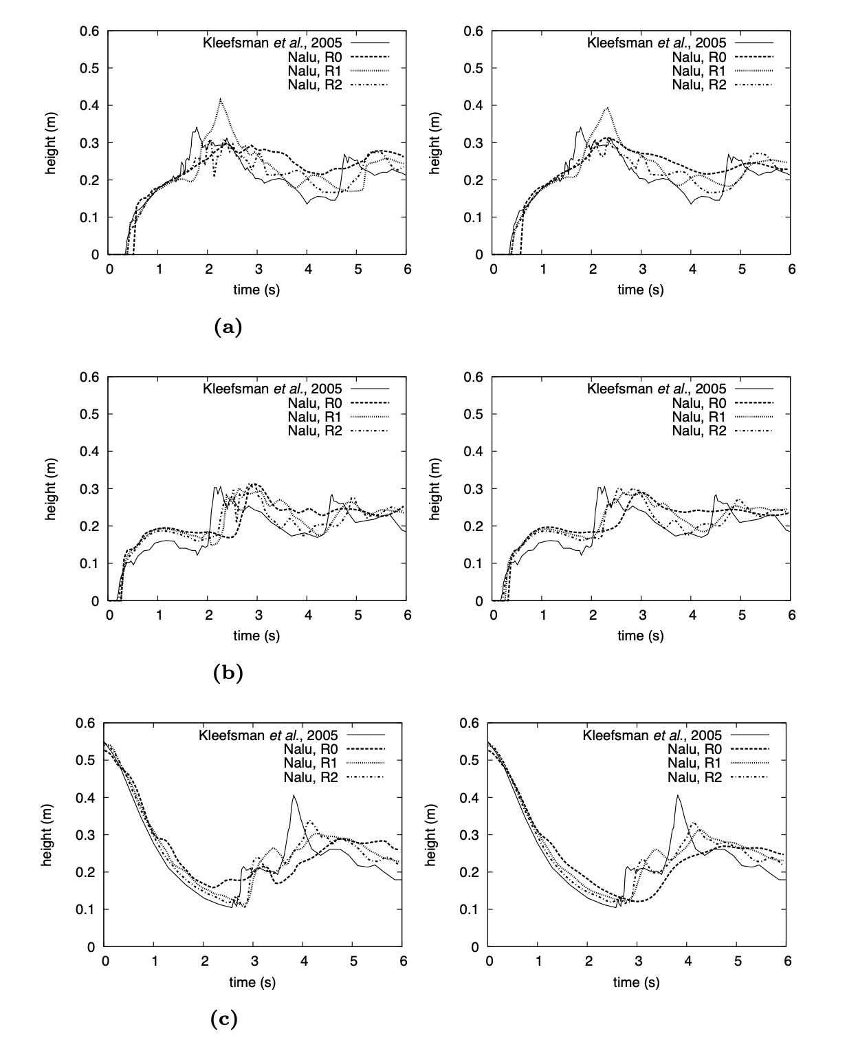
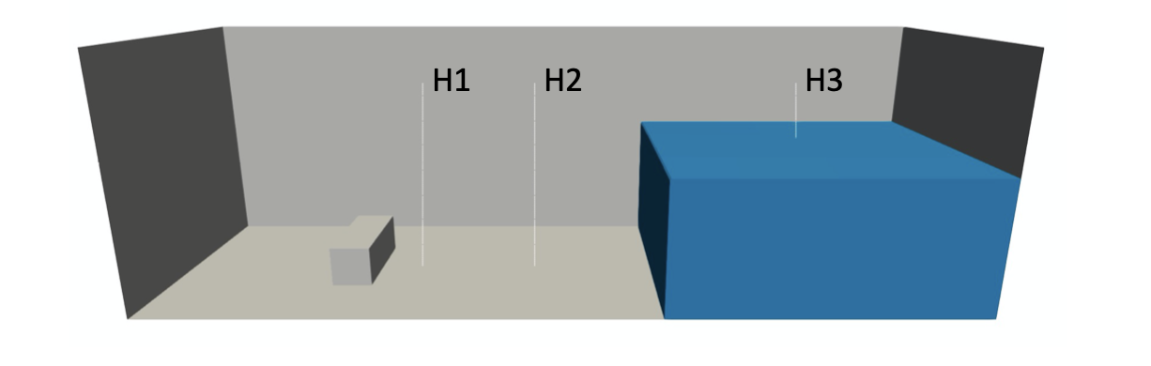
Dam Break Validation
H1
Comparison heights predicted for sharpened (left column) and smoothed (right column)
H2
H3

Slide 20
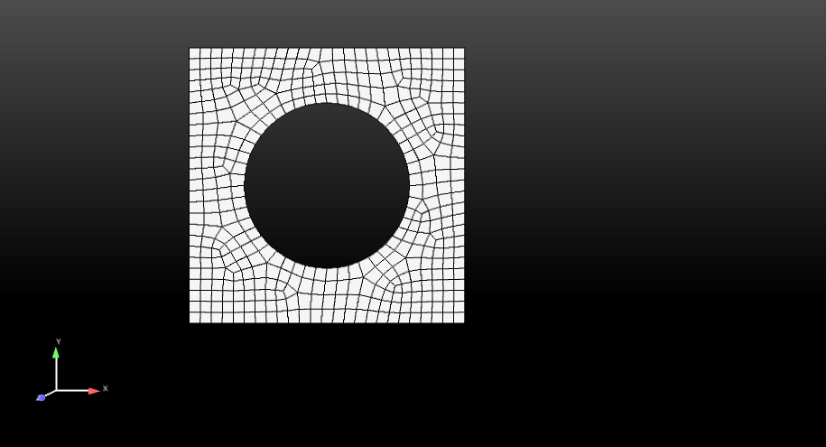
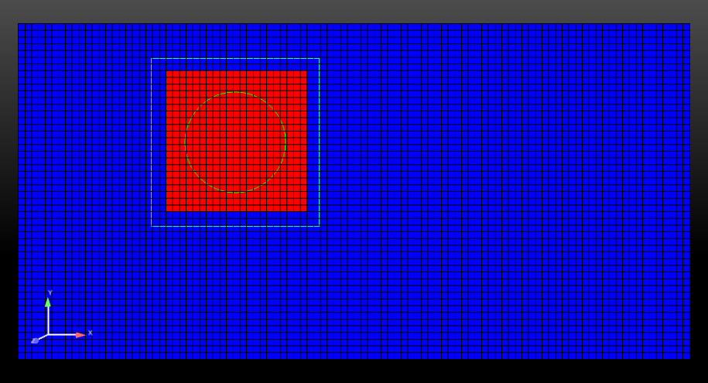
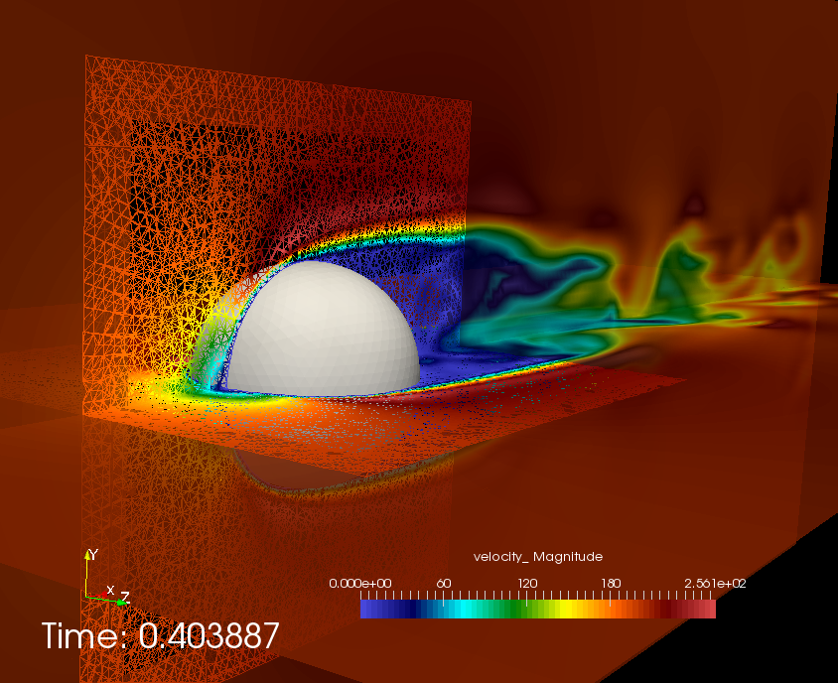
Implicit low-Mach Overset
Base overset (STK-based hole cutting) with fixed, prescribed, or general motion (six-DOF)
Fully implicit-based
Constraint-based
[1]
BLOCK_3 (newly declared and
changed part)
BLOCK_2
BLOCK_1
Surface_1 (read in)
Surface_101 (newly declared and changed part)

Slide 21


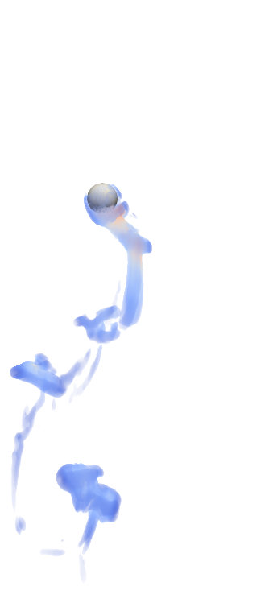
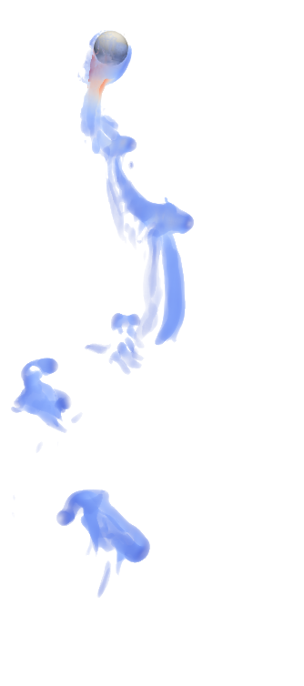
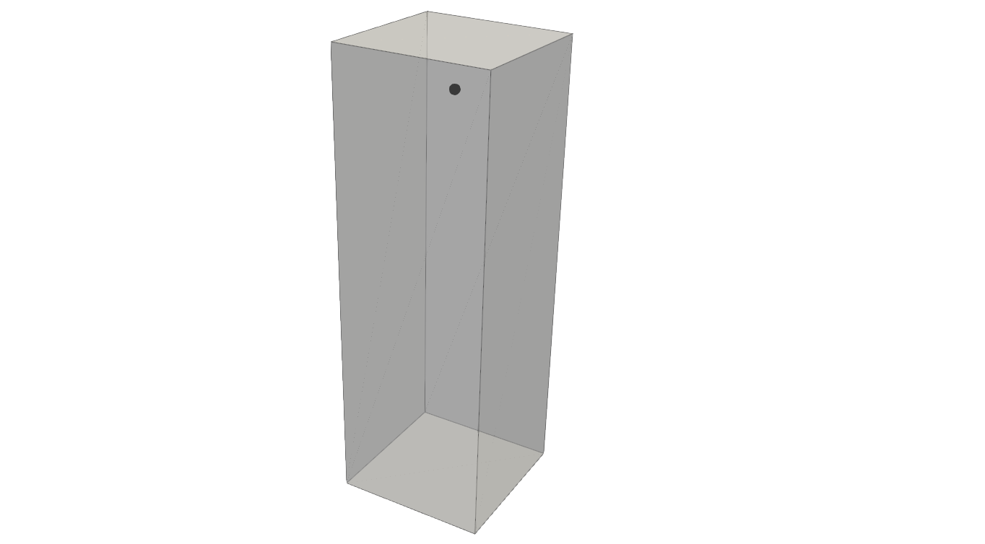
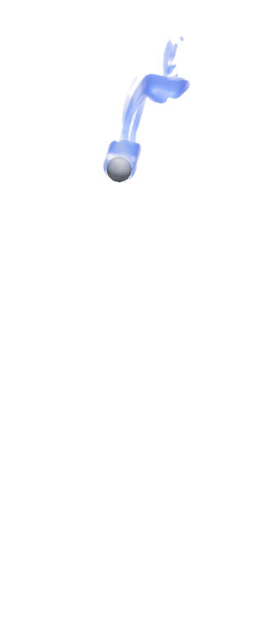

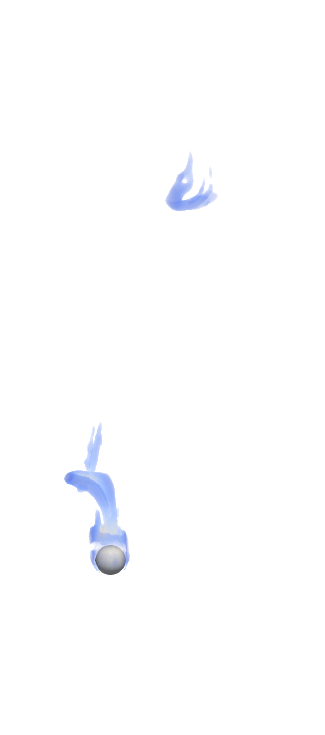
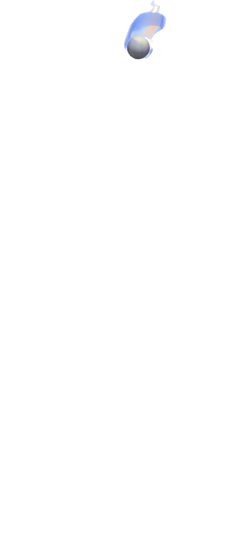
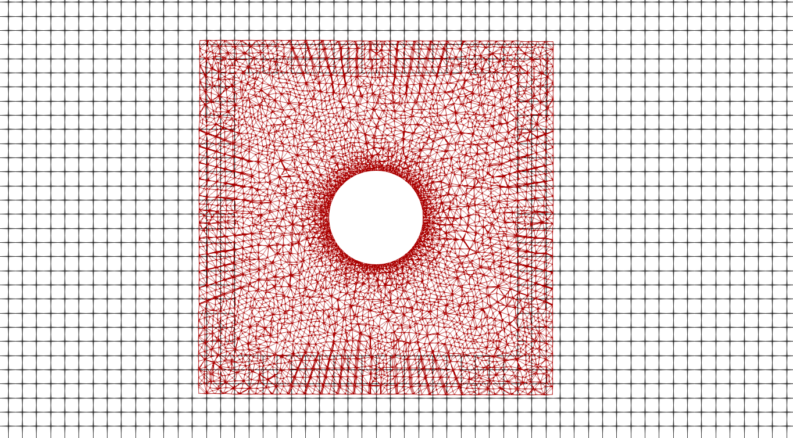
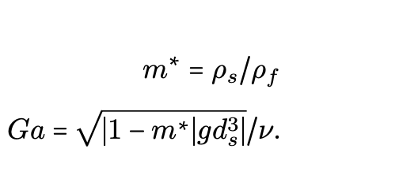
Overset Rise and Fall: Establish Stability of Overset
Galileo number dependency run for rise and fall
Comparisons to Horowitz and Williamson, “The effect of Reynolds number on the dynamics and wakes of freely rising and falling spheres”, JFM 651 (2010) 251–294.
45 d_{s}
15 d_{s}
15 d_{s}

Slide 22


Overset Rise and Fall: Validation Results
Falling: Ga = 160.7, m = 1.41
QoI: Angle?
Rising: Ga = 476, m = 0.27
QoI: Zig-zag and four-mode?

Slide 23


Validation: Unmoored Buoy Drop (Quiescent Conditions)
Comparisons are made to experimental data from the UK Centre for Marine Energy Research (UKCMER) of the WEC vertical displacement given in Ransley et al., Renew. Ener., 2017
5 m
5 m
0.5 m
3 m
0.25 m
0.25 m

Slide 24


Validation: Unmoored Buoy Drop (Quiescent Conditions)
Displace buoy vertically and track center of mass with time
Matched experimental dataset and showed grid convergence
Showing better match than other works found in literature from what we know, e.g., WEC vertical displacement given in Ransley et al., Renew. Ener., 2017.
0.31 m

Slide 25

Buoy Dropped Into Quiescent Pool; large displacement limit
Large-displacement sample case run that can serve as a numerical benchmark

Slide 26


Large Displacement Test Case: Explore Center of Mass
0.44 m
0.31 m
High COM
Low COM

Slide 27

Validation: Moored Buoy Drop (Quiescent Conditions)
Displace buoy vertically and track center of mass with time
Matched experimental dataset and showed grid convergence
Again, showing better match than other works found in literature from what we know, e.g., WEC vertical displacement given in Ransley et al., Renew. Ener., 2017.
0.31 m

Slide 28







COVID-19 Transport and Transmission
Objective: Modeling droplets from human coughs in complex environments, including a link to probability of infection (short-range)
First: Establish a credible, multi-physics mod/sim capability to understand droplet deposition and pathogen transport originating from synthetic human coughs/breathing Sandia Rapid LDRD
Domino, S. P., Pierce, F., Hubbard, J., "A multi-physics computational investigation of droplet pathogen transport emanating from synthetic coughs and breathing", Atom. Sprays, 2021
Second, Drive a science-based approach to understand airborne transmission with probability of infection COVID-19 estimates in common public space use-cases
Domino, S. P., "A case study on pathogen transport, deposition, evaporation and transmission: linking high-fidelity computational fluid dynamics simulations to probability of infection", Int. J. CFD, 2021
Sierra/Fuego synthetic sneeze sim with droplet distribution from Yang et al, J. Aerosol Med, 2007 including pathogen probability
(1 m/s streamwise wind)
u_{z}
g_{y}
Q-criterion 1 m/s

Slide 29







First Objective: Establish a Credible high-Fidelity Multi-physics tool
Deploy multi-physics code capability: Sierra/Fuego low-Mach turbulent reacting flow code with point-Lagrangian coupling; credibility established for a variety of use cases
Credibility/Validation for droplet evaporation (Ranz and Marshall, 1952) and plume dynamics (Fan, 1967)
Multi-physics coughs passive breathing fluid/droplet simulations w;w/o crossflow/plexiglass

Slide 30



Second: Linking Multi-physics Mod/Sim to Probability of Infection
How can our high-fidelity physics modeling tool support probability of infection prediction?
Watanabe et. al, “Development of a dose-response model for SARS coronavirus”, Risk Anal., 2010
San Francisco open-space configuration
Receptor probe(s) to establish risk
Cough modeling using local-refinement (critical for turbulent fluid mechanics) enabled by ASC NGS

Slide 31










Kneeling Humanoid; Cough in 0, 1, and 10 m/s Crossflow
10 m/s crossflow
0 m/s
1 m/s
10 m/s

Slide 32



Standing Humanoid Coughing (10, 20 m/s); 0 m/s Crossflow
~4 meters
~3 meters
10 m/s
10 m/s
~5 meters
~4 meters
20 m/s

Slide 33


Standing Humanoid Coughing (10, 20 m/s); 0 m/s Crossflow: Wall
10 m/s
10 m/s
~4 meters
20 m/s

Slide 34





Kneeling Humanoid Coughing; 1 and 10 m/s Crossflow (streamwise)
0 m/s
10 m/s
1 m/s
10 m/s
10 m/s
~4 meters
20 m/s

Slide 35




Kneeling Humanoid Coughing; 1 and 10 m/s Crossflow (spanwise)
R⁰ = 500 μm
10 m/s
10 m/s
R⁰ = 1000 μm
1 m/s
10 m/s
~4 meters
20 m/s

Slide 36


Developed Open-Source BSD-clause 3 Distribution Policy
Philosophy: Open-source collaborations
Philosophy: Open-source collaborations
https://github.com/NaluCFD
https://githib/copm/exawind
Academic Partners:

Slide 37
Conclusions
Many possible research themes to explore during a PSAAP internship
Contact spdomin@sandia.gov for more information

